Slide 1

ECON 1BB3 – Introduction to Macroeconomics
Notes:
Short answer question for the benefit:
Stock and flow variables.
Not enough computer lab space.
Qd and Qs are flow variables.
3 short answer questions. 1 super-easy 1 hard.
------------------------------------------------------------
Per capita GDP is a good measure of economic well-being. Countries with high per capita GDP = literacy higher, infant mortality rate lower, life expectancy higher.

Slide 2
Clicker
Notes:
Which country has the highest per capita GDP? Liechtenstein.
World fact book collects this type of data in the world.
Liechtenstein → 118 000 per person. (they have low business taxes, lots of finance/bankers)
US → 48 000
Qatar →
Norway →

Slide 3
Productivity
productivity: the quantity of goods and services that a worker can produce for each hour of work
determinants of productivity:
1. physical capital
2. human capital
3. natural resources
4. technological knowledge
Notes:
Why is it that some countries grow faster than others?
Productivity: gives a country a higher per capita GDP.
Countries with higher productivity have higher GDP. Output per hour worker. Each worker can produce more stuff.
Physical capital is the existing machinery, equipment, factories, roads, housing, etc. that are used to produce other resources. How much capital each worker has to use.
Human capital is what we invest in when we become educated.
Natural resources includes mining, fishing; using resources from the environment.
Technological knowledge is using our knowledge on how to combine inputs and produce outputs; the existing knowledge (ex: books in a library)
Human capital is the amount of time we spent on learning things (i.e. going to school, building human capital, reading books in other words reading the technological knowledge). How much time we put in to reading the books at the library. Learning how to do things and accumulating knowledge.
Can have access to have high #4 but low #2 b/c #2 hasn’t put in the time to learn about the activity.
Production function shows how we combine inputs to produce output.

Slide 4
Production function
production function: shows how we combine inputs to produce output
Y = A x f(K, L, H, N)
F = function
Y = GDP, expenditure, outcome, output, etc.
K = physical capital
L = Labour
H = human capital
N = natural resources
A = technology
→ Will combine with GDP equation!
Notes:
Make two assumptions with this production function that will allow us to do certain things:
Production function has constant returns to scale. If we double all the inputs, then we get twice as much output. If you multiply inputs by x, then we get x as much inputs.
Allowing x = 1/L, production function can be written in per capita terms. This production function talks about how much output per worker, capital per worker, etc.
The original production function was aggregate output. Output in the entire economy depends on how much capital, labour, human capital, natural resources in the entire economy.
Two inputs: Capital and labour

Slide 5
Production function
Output = expenditure = income
physical capital
human capital
Y = A · F (K, L, H, N)
natural resources
technology
labour
Notes:
Y is a function of (------)

Slide 6
Clicker
Notes:
Which of the following is human capital?
Breakfasts served in a company’s café
Understanding how to use a company’s accounting software
Training videos for new corporate employees → more on technology
All of the above

Slide 7


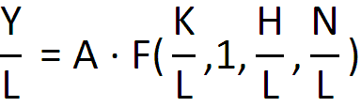
If a production function exhibits constant returns to scale, then doubling all inputs leads to a doubling of output.
Notes:
2 ASSUMPTIONS ABOUT Y
Diminishing marginal products. A function that has constant return to scale.
Increase return to scale = more than twice the input.
Decrease return to scale = less than twice the input
Constant return to scale, doubling all inputs leads to doubling output
What would we need to do to get more _______?
Equations show if more capital/knowledge = more wealth
We can look at total output as a functino of the various inputs (KHLN)

Slide 8
Diminishing marginal product
product: output
marginal product: the extra output produced by increasing an input by 1 unit
diminishing marginal product: the extra output produced by adding the 19th unit of labour is smaller than the extra output produced by adding the 18th unit of labour
Notes:
Diminishing marginal product still increases output when we add an additional input of x, but the increase in output is less than before.
→ At some point as we increase input by adding more workers, but eventualy we get to the DMP where adding additional labour will decrease the output (output still increase, but just less than before)
→ Tell us variables on axis and shape of function of the slow growing model
If increase labour by one unit, how much extra output gets produced?
Diminishing marginal product = as add units of labour; still producing more outputs but the amount produced is less per extra worker.

Slide 9
Catch-up effect
catch-up effect: poor countries tend to grow faster than rich countries
Notes:
Increasing saving rate in a country does NOT lead to a permanent increase in the growth rate.
It does lead to an increase in the level of Y/L, but the growth rate does not stay high forever.
Two assumptions with PPF:
Constant returns to scale – we can draw production function in per capita terms (Y/L)
Diminishing marginal product – tells us about the shape of the production function (see next page)

Slide 10
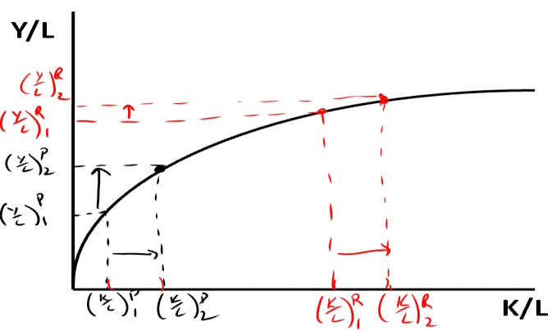
Catch-up effect
Notes:
→ Slope getting flatter because less production the more you produce
→
Shape of the production function tells us the catch-up. Comparing a poor and rich country: what happens to each other when we increase per capital per worker by the same amount?
P1 = poor country. They can produce Y/L because they have a certain amount of K/L
R1 = rich country has a high output per worker. They have higher capital per worker.
What happens in both countries if we increase K/L by the same amount in both countries? (Same horizontal distance in both countries. The input of K/L is the same in both countries, BUT the increase in input for the poor country is higher than in the rich country. This makes sense, because if you’re not really good at producing things, then there is a lot of room for upward improvement. If you’re already good at doing something, there is a lot less room to getting better.
---------------------------------
Y/L = output per worker
K/L = capital per worker
Using more of capital will decrease the amt that is made (i.e. Willy dog stand)
Add more inputs, make more T-shirts = straight line? Wrong.
Blue line? Wrong, can’t start off with stuff magically.
TEST #22222222222222222222222222222222222!!!!!!!!!!!!!!!!!!!!!!!!!!!!!!!!!!!!!!
A poor country would have low per capita GDP (blue dot)
Rich country would have high per capita GDP (red dot) What happens if both countries increase output per worker
We want to increase capita per worker by the same amount for both rich and poor countries. Increase (K/L)1 → (K/L)2. There’s a lot of room for improvement for poorer people (i.e. like people with lower marks) and there’s a lot less room for improvement for people with higher marks.

Slide 11
Policies
What can government policy do to raise productivity and living standards?
1. Encourage saving
    consume less and save more
    eg. impose a consumption tax
2. Allow foreign investment
    Foreign some profit from foreign direct investment (FDI) would be brought home and would help boost the economy (only pertains to rich country)
(K)
(K)
Notes:
Policies
- Chapter is very wordy!! Read about policy and think about how it applies to the equation (aggregate output equation) and production function (per worker equation).
Encourage saving, why? Only want to increase right hand side…must increase left hand side…but how?
- encouraging saving will increase capital stock. More saving in the economy = more investment in the economy. Investment = purchases in new capital goods. More investment = more capital stock in the future
- to encourage saving, can impose consumer tax → consumption tax only kicks in when consume sthg. Investment of any kind would increase domestic stock.
Eliminate income taxes altogether
if saving rate increases, likely that capital will increase as well.
Allow foreign investment will also increase capital stock.
- allowing foreign company to come in an build a factory is good for the economy b/c it increases capital stock. It is not a good thing for poor countries to do b/c profits of the operation will leave the country; it would be better for a domestic company to build a factory. BUT if only option is: foreign country invest or nobody else invests, you would rather have the foreign country invest.

Slide 12
Policies
3. Spend on education
        more educated individuals = more ideas for society
        brain drain problem: emigration of highly educated people to rich countries who can benefit from a higher standard of living
4. Improve property rights and reduce political instability
(H)
(K,A)
Notes:
3. Spending on education increases human capital. Educating more people will lead to more ideas for the society.
Problem: brain drain – emigration of educated to richer countries.
-brain drain happens in poor countries, they spend time for educated citizens, then they move out of the country. The country that paid for that education is not getting the benefits of educating their citizens
4. Improve property rights and reduce political instability. More investment, more capital, improvements in technology. People won’t invest in a country if they think someone can come along and take profits. They need a strong legal system in place and contracts need to be enforced so that people are willing to take risks and invest.
→

Slide 13
Policies
5. Free trade
    can be a substitute for developing your own technology
6. Research and Development – R&D
        grants (eg. funded research at universities)
        patent system (enhances the incentive for individuals and firms to engage in research)
        7) Health and NUtrition
(A)
(K,A)
Notes:
5. Free trade
- Can help with technology (i.e. a lot of growth after WWII in Japan and Korea, they imported goods from the states and learned how to build them, then exported them back)
6. Research and development can affect capital stock and technology.
Governments give grants to people in universities to fund research and development to improve and increase technology
- Patent system = allows profit from the new invention to go to the researcher/discoverer/inventor gives people incentive for doing research and therefore improve technology

